Slide 1

Supporting Choices Workshop
Friday, July 14, 2017
Hilton Garden Inn
Orlando, FL

Slide 2

Pre-Test
Take a minute and
please complete

Slide 3

Introduction
Sponsors
Team

Slide 4

Today’s Goals
  Learn about:
  Helping students and families with transitions planning,
  Talking about civil rights,
  Identifying legal status, and
  Discussing available resources

Slide 5
OVERVIEW
  Self Advocacy
  Panel Discussion on Legal Rights
  Developing Abilities Materials and Breakout Sessions
  Classroom Techniques
  Online Curriculum

Slide 6
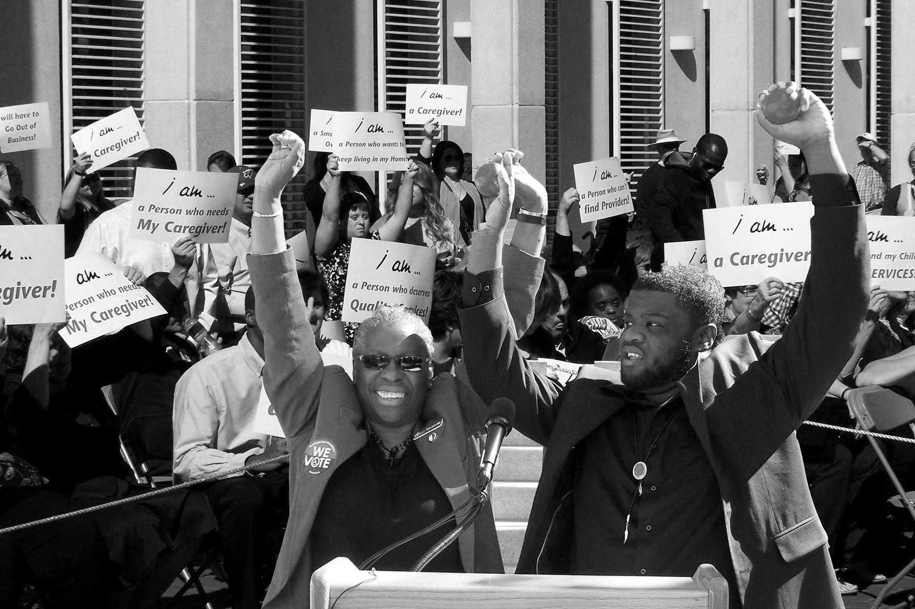
Self Advocacy
Daniel Jordan

Slide 7

Panel Discussion

Slide 8

Why is it important to understand the legal rights that transfer to students at age 18?
Daniel Jordan,
Former Student’s Perspective
Anna Jordan,
Parent Perspective
Amanda Lewis,
Teacher Perspective

Slide 9
Developing Abilities and Restoring Rights

Slide 10
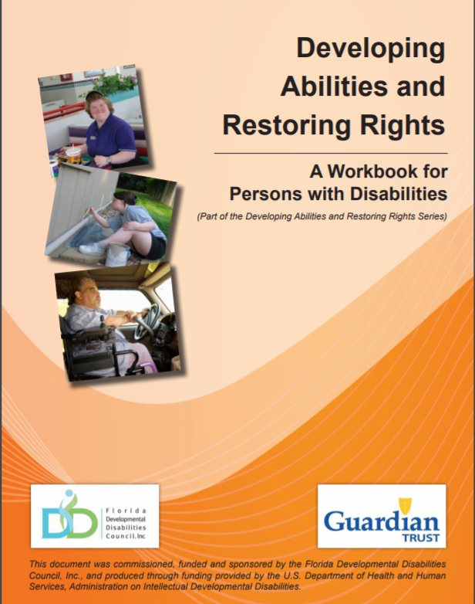
Developing Abilities
  Workbook for Persons with Disabilities
  Guide for Parents, Teachers, and Supports
  Legal Guide for Attorneys, Judges, and Legal Professionals

Slide 11

Breakout Sessions

Slide 12
Demonstration on Classroom Techniques

Slide 13
Introduction of Online Modules

Slide 14


Questions?

Slide 15
Post-Test and Evaluation
Take a minute and
please complete

Slide 16
Thank You!

